Slide 1
Assignment Instructions
Refer to the table below that lists seven breakfast items sold in 12 transactions. Use the data given in the dataset to complete the activities listed on the next slide.
Transactions | Bread | Milk | Dosa | Pulses | Coffee | Omelette | Juice
1 | 1 |  | 1
2 | 1 | 1 |  | 1 |  | 1
3 |  |  |  |  |  | 1 | 1
4 |  |  | 1
5 | 1 | 1
6 | 1 |  | 1 |  | 1
7
8 | 1 | 1 | 1
9 | 1 | 1
10 |  |  |  |  | 1 | 1 | 1
11 | 1 |  | 1
12 |  | 1 |  |  |  |  | 1

Slide 2
Assignment Instructions
Calculate from the given dataset and enter your response to the following activities using this template:
Calculate the support value for each product from the given dataset
If minimum support is fixed at 22%, then which of the items are significant from the data. That is find out items having support greater than or equal to 22%
Create a table consisting of all 2-itemsets or pairs of items, having minimum support of 22%
Calculate support value for each of the 2-itemsets created from the above step
Calculate confidence of all these 2-itemsets
If the confidence is fixed at 65% or more, then find out all frequent 2-itemsets from the 2-itemsets identified in the previous activities
Calculate the lift of the association rules and list the two rules to be dropped
Calculate the lift of the two rules dropped in Activity 7
Compare support and confidence of the derived four rules from activity 7 and justify the selection of the two rules which can be considered as the final rules

Slide 3
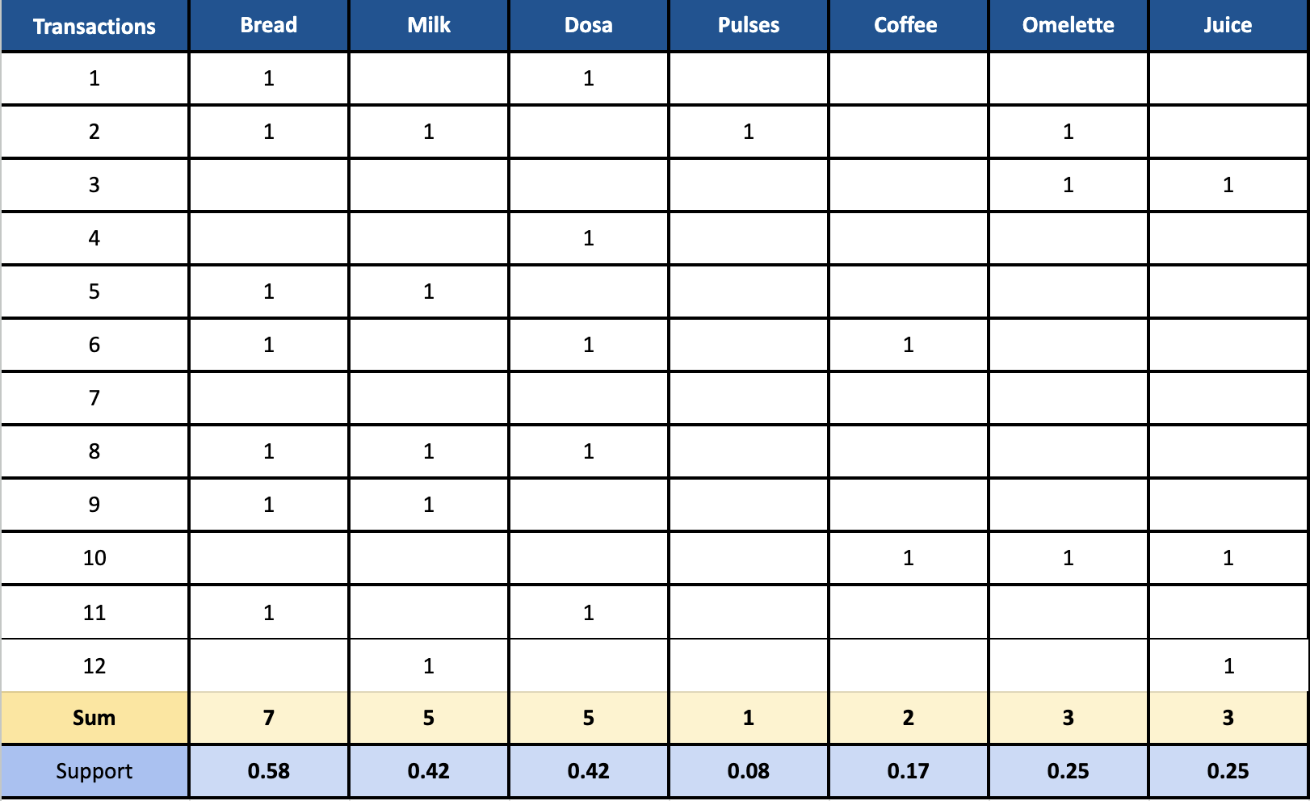
Calculate the support value for each product from the given dataset
<Calculate and paste the screenshot of your findings here>

Slide 4
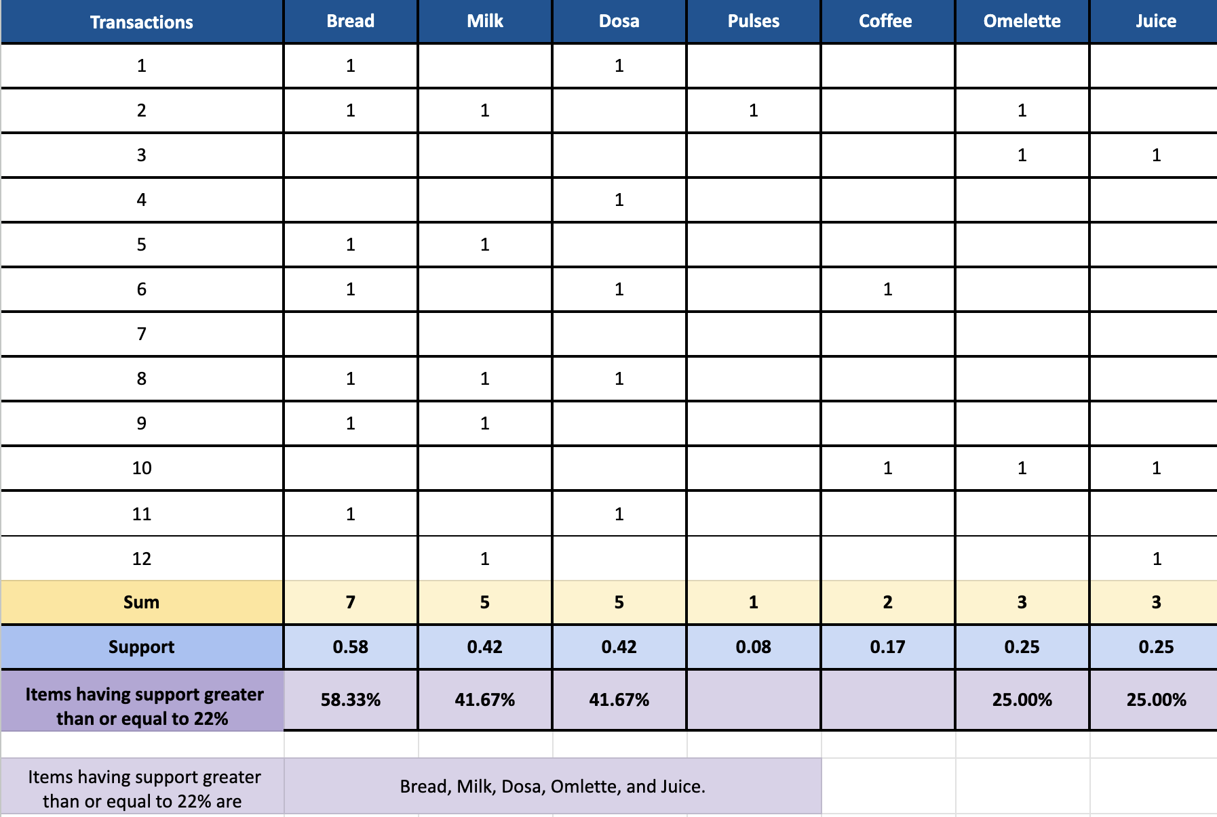
If minimum support is fixed at 22%, then which of the items are significant from the data. That is find out items having support greater than or equal to 22%
<Calculate and paste the screenshot of your findings here>

Slide 5
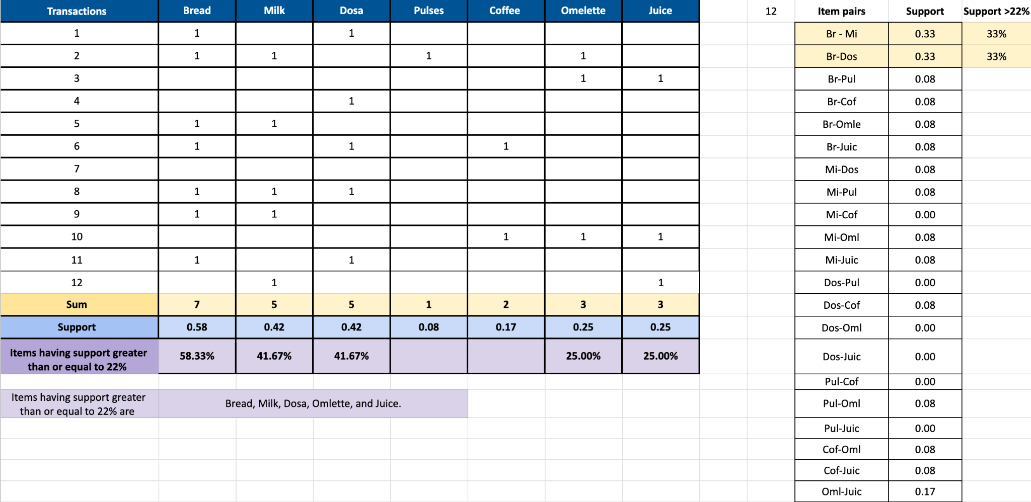
Create a table consisting of all 2-itemsets or pairs of items, having minimum support of 22%
<Calculate and paste the screenshot of your findings here>

Slide 6
Calculate support value for each of the 2-itemsets created from the above step
<Calculate and paste the screenshot of your findings here>

Slide 7
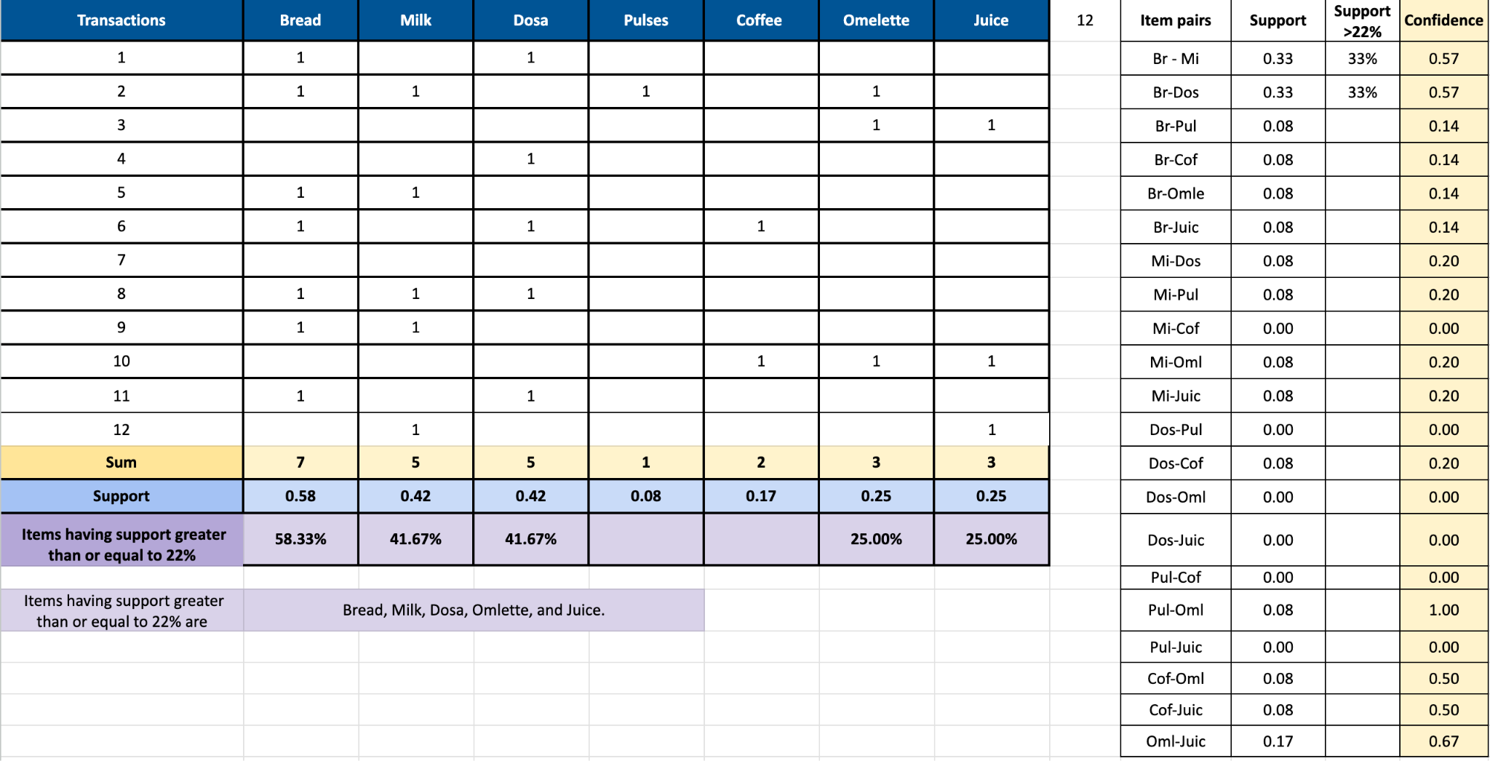
Calculate confidence of all these 2-itemsets
<Calculate and paste the screenshot of your findings here>

Slide 8
If the confidence is fixed at 65% or more, then find out all frequent 2-itemsets from the 2-itemsets identified in the previous activities
<Enter your response in the following table>
2-Itemsets | Confidence
Pulse-Omlette | 100% (1)
2-Itemsets | Confidence
Omlette Juice | 67% (0.67)

Slide 9
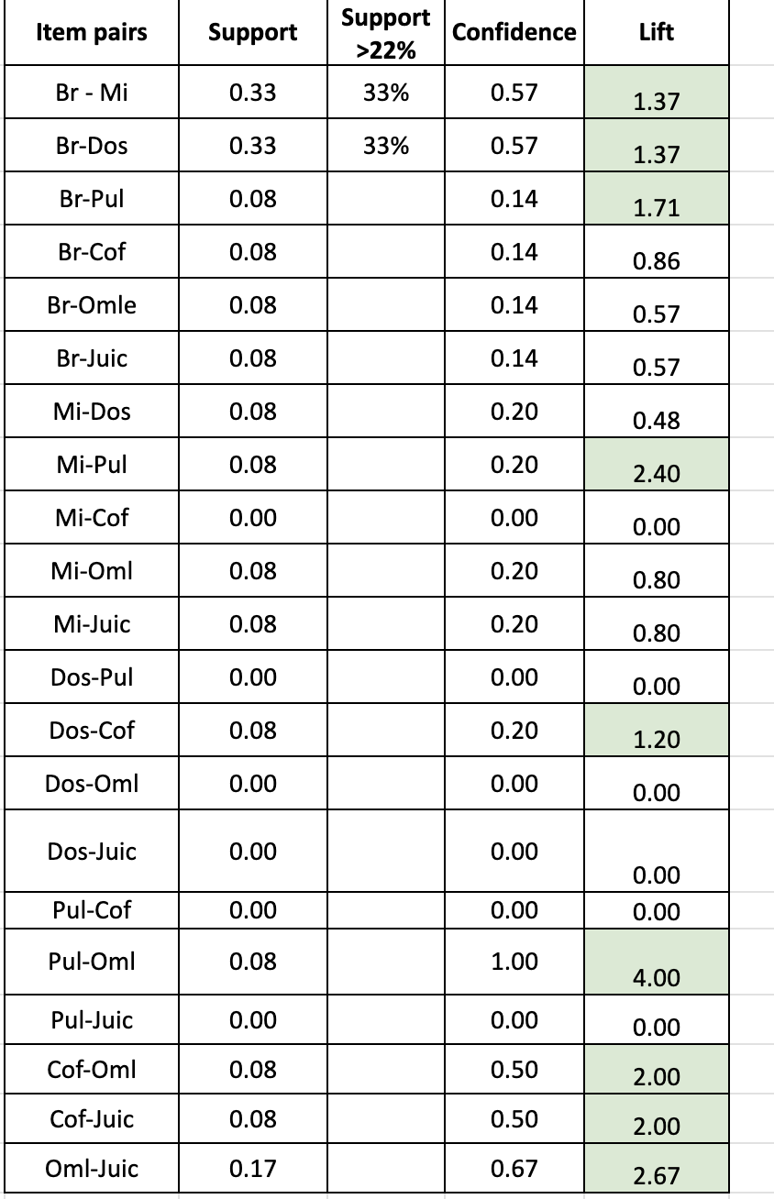
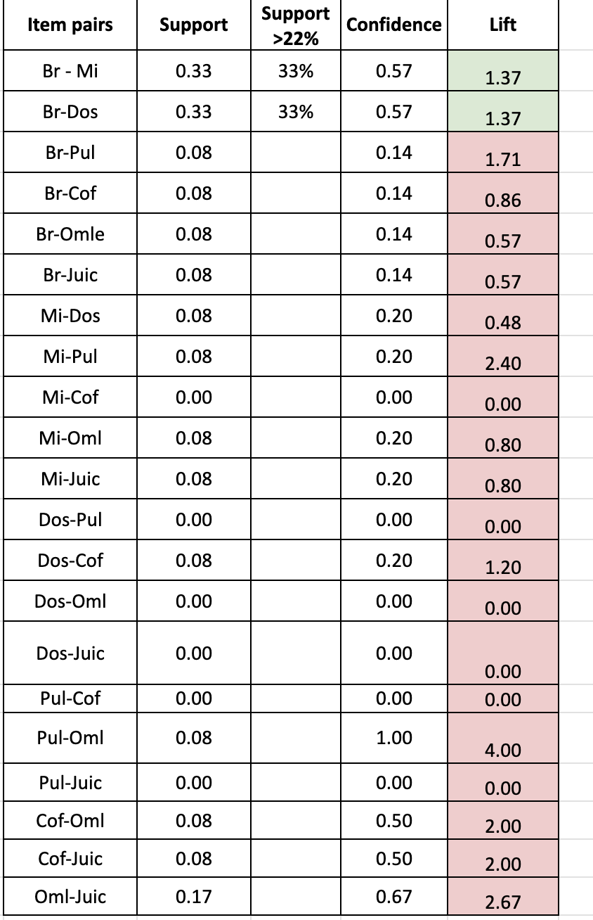
Calculate the lift of the association rules and list the two rules to be dropped
Valid rules and lift of these rules:
The two rules which cannot be part of the final rules as they do not satisfy the support value of 22% are as following:
The green cells in the lift column conform with the minimum 22% itemset support). The red cells in the lift column are the rules that do not satisfy the minimum support value.

Slide 10
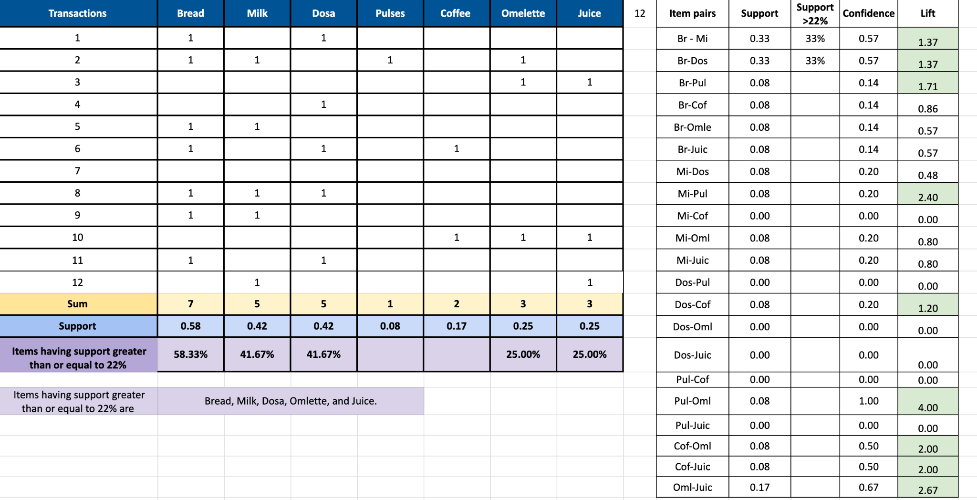
Calculate the lift of the two rules dropped in Activity 7
<Calculate and paste the screenshot of your findings here>

Slide 11
Compare support and confidence of the derived four rules from activity 7 and justify the selection of the two rules which can be considered as the final rules
Considering both support and confidence from the final data, the two final rules that can be considered are:
Bread > Milk, Bread > Dosa, Pulses > Omlettte, Coffee > Omlette, Coffee > Juice, Omlette > Juice, can be chosen since they show very good strength in confidence and lift values. However, if were to choose the strong associations including frequency and minimum support value of item pairing of 22%, then only Bread> Milk and Bread>Dosa will satisfy the rules.

